Slide 1

UML Diagrams
Classroom Management System
Tasnim Ferdous 180041108
Sidratul Muntaha 180041118
Farhan Ishmam 180041120

Slide 2
UML Diagram
A UML diagram is a diagram based on the UML (Unified Modeling Language) with the purpose of visually representing a system along with its main actors, roles, actions, artifacts or classes, in order to better understand, alter, maintain, or document information about the system.
Unified Modeling Language
02

Slide 3
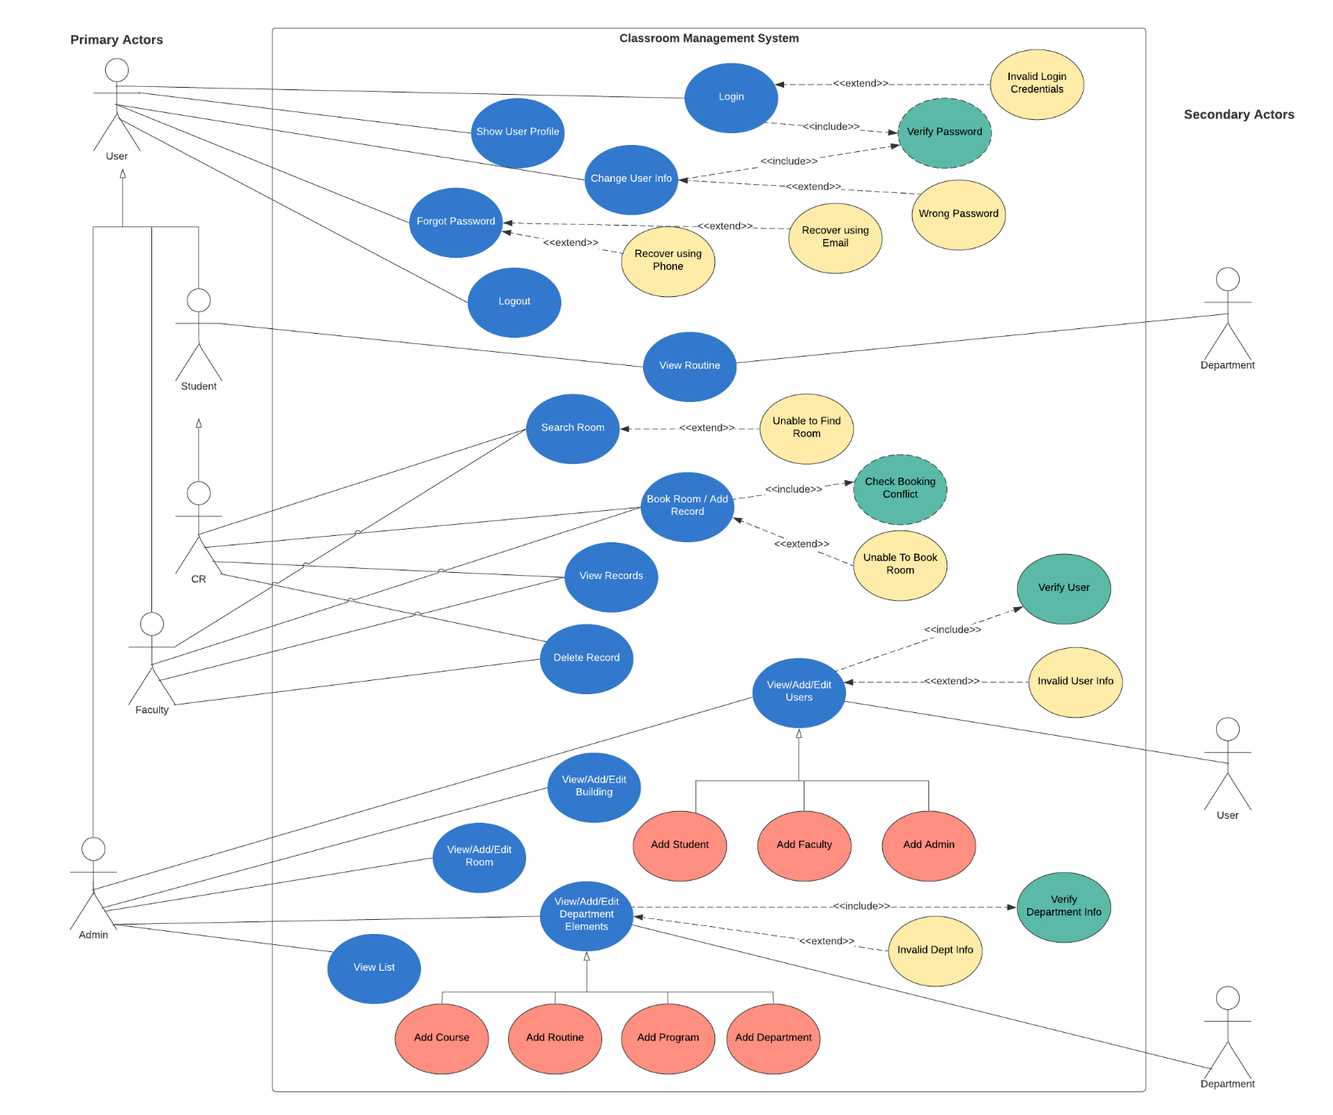
Use Case Diagram
03

Slide 4
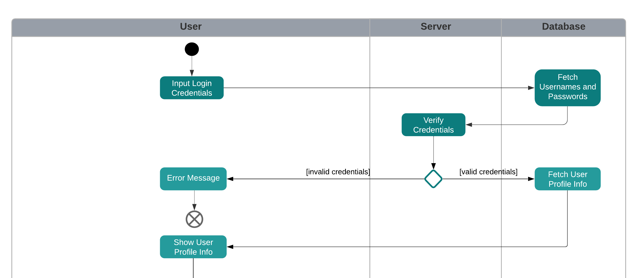
Activity Diagram
04

Slide 5
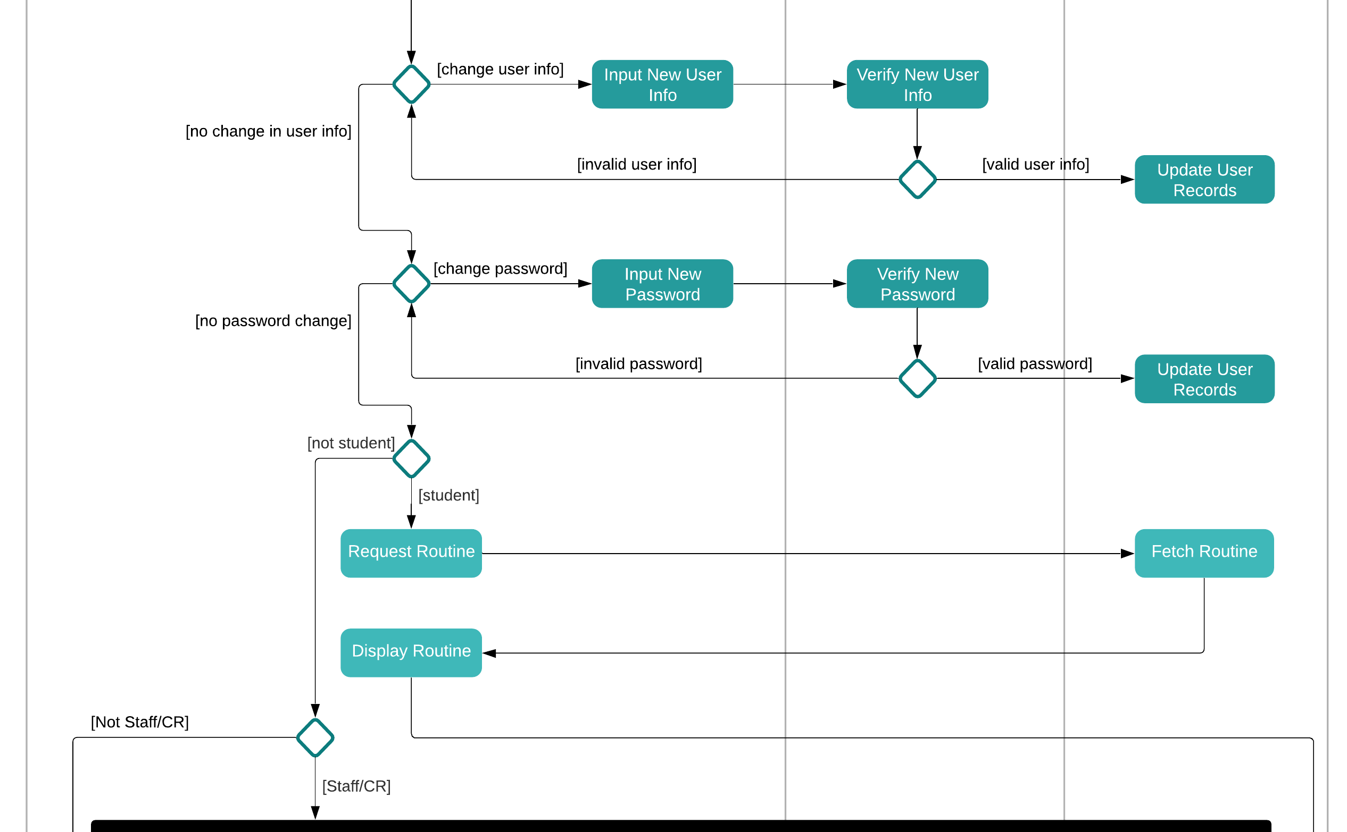
Activity Diagram
04

Slide 6
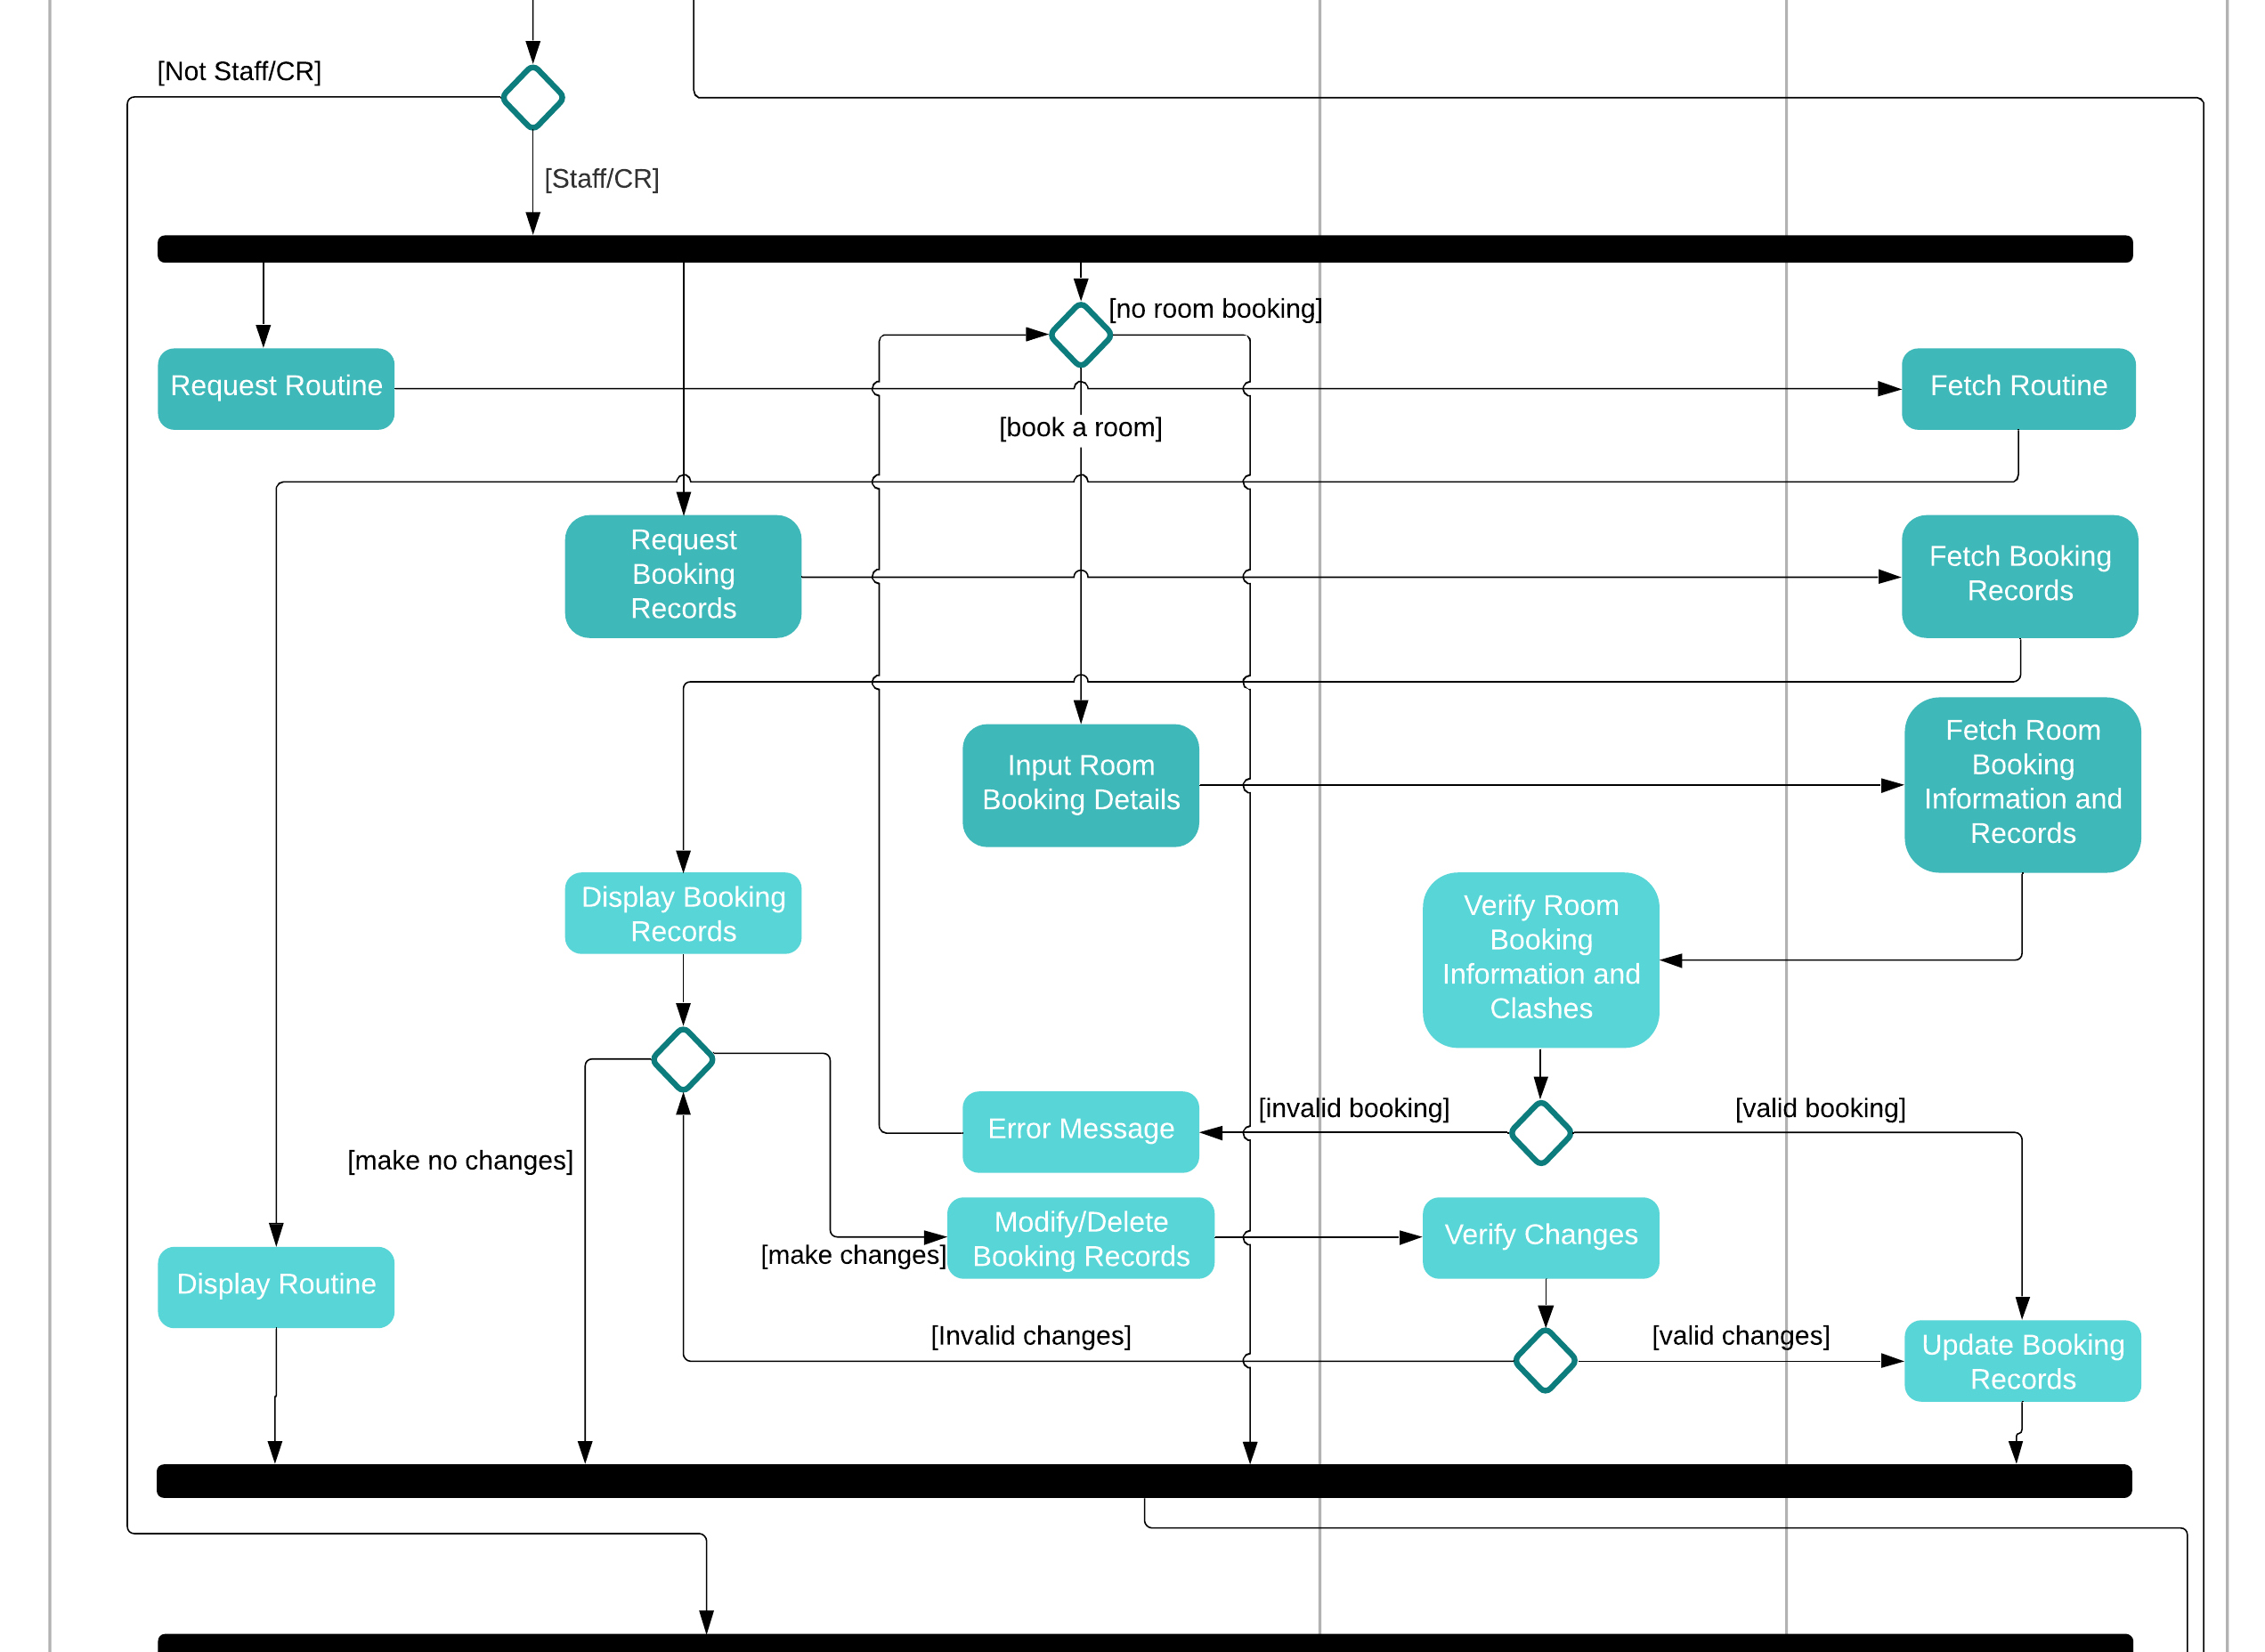
Activity Diagram
04

Slide 7
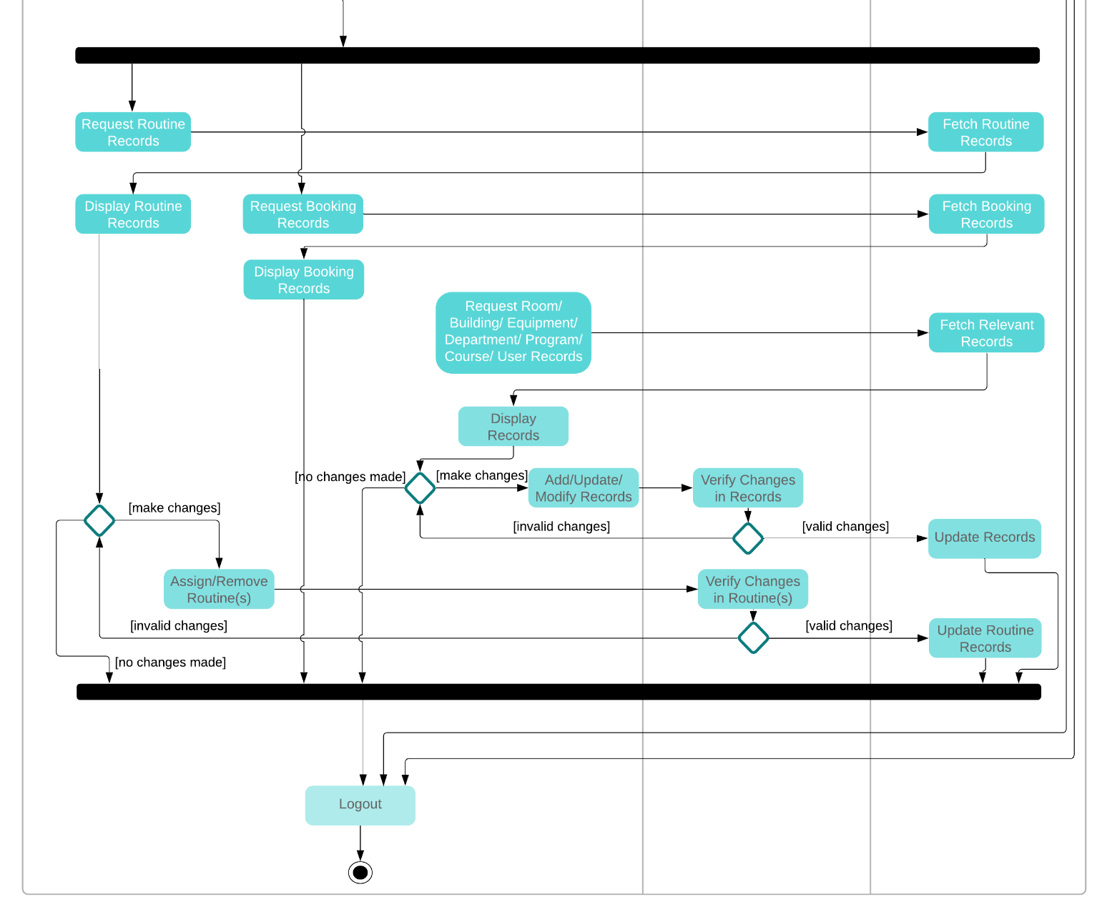
Activity Diagram
04

Slide 8
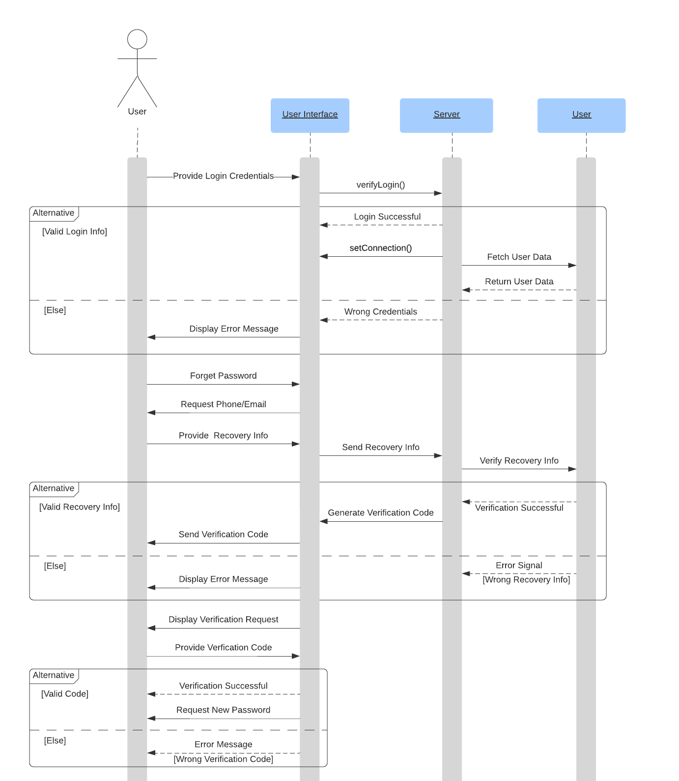
Sequence Diagram
(User)
05

Slide 9
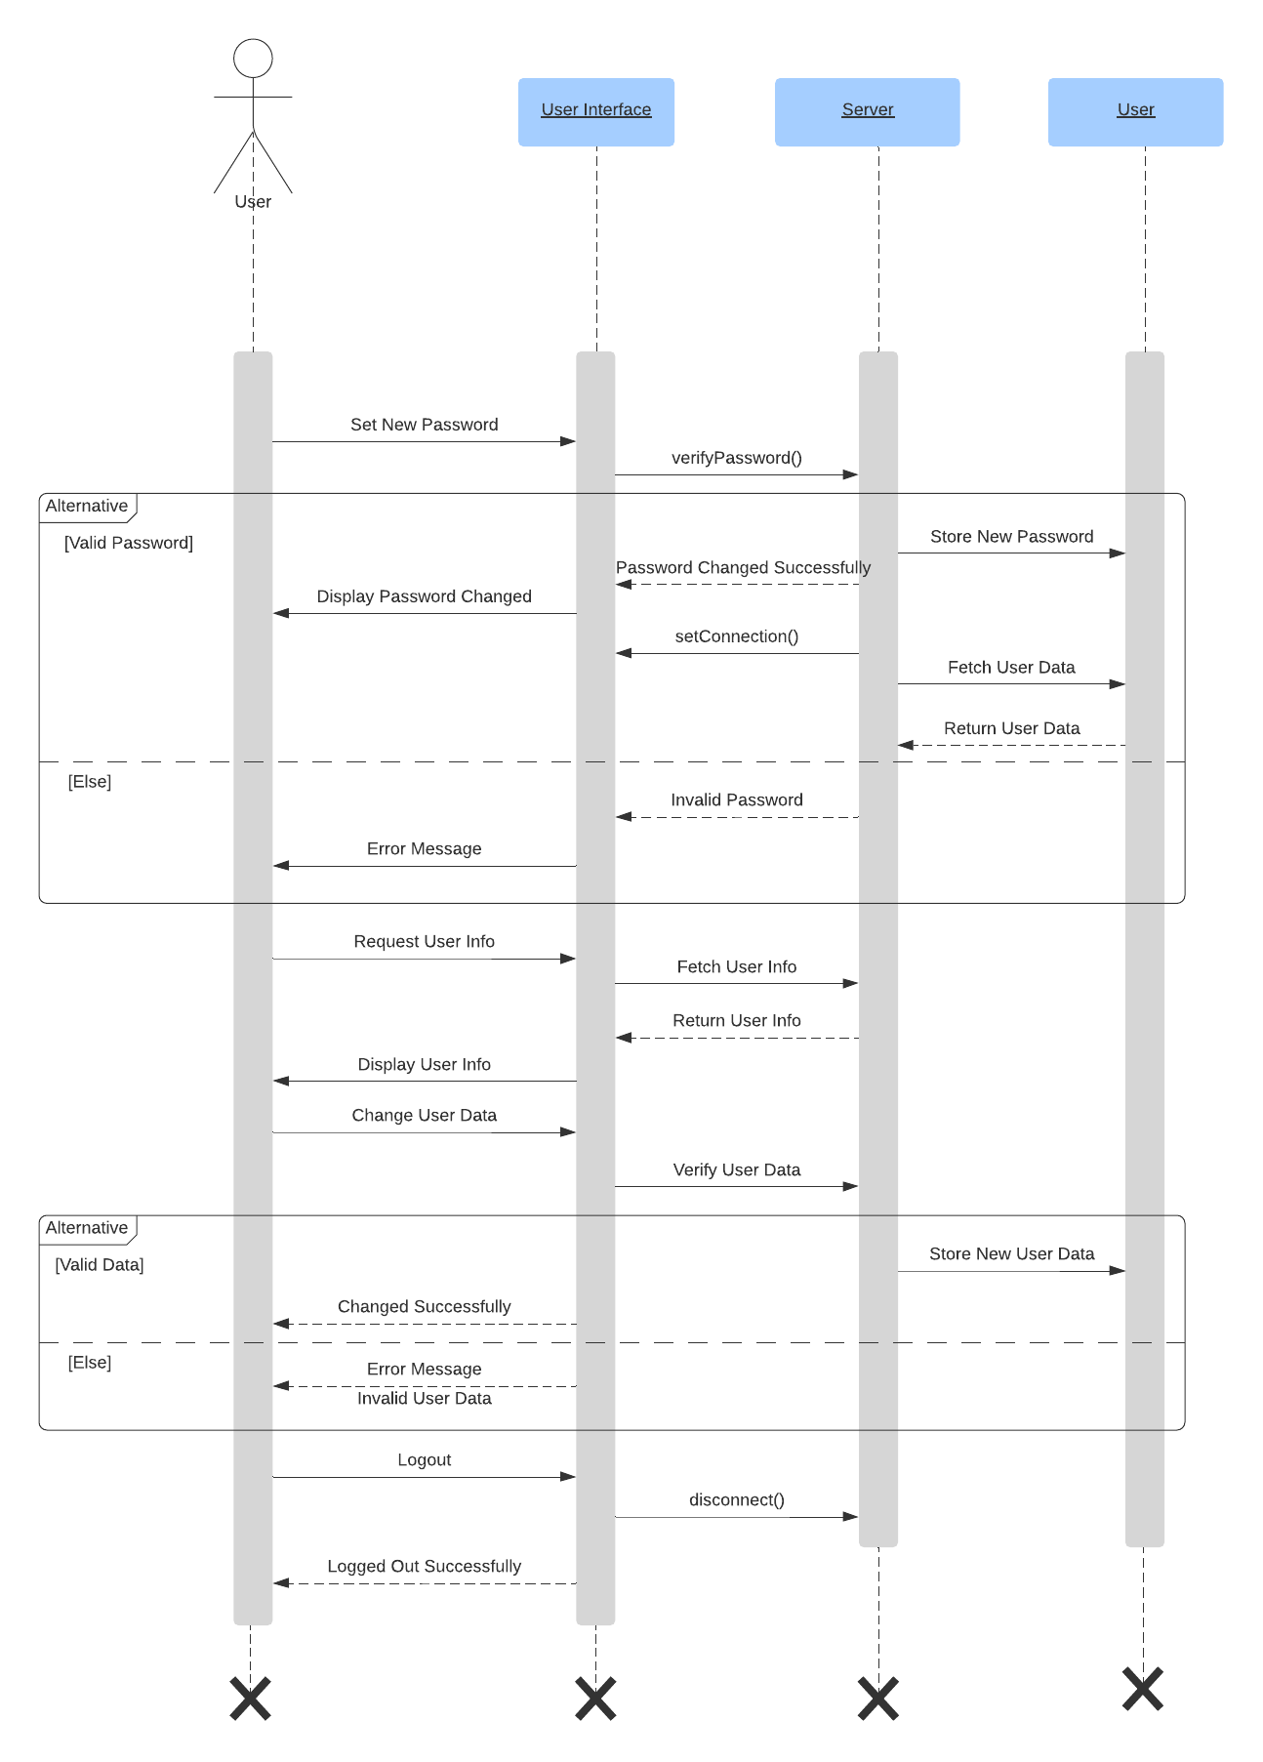
Sequence Diagram
(User)
05

Slide 10
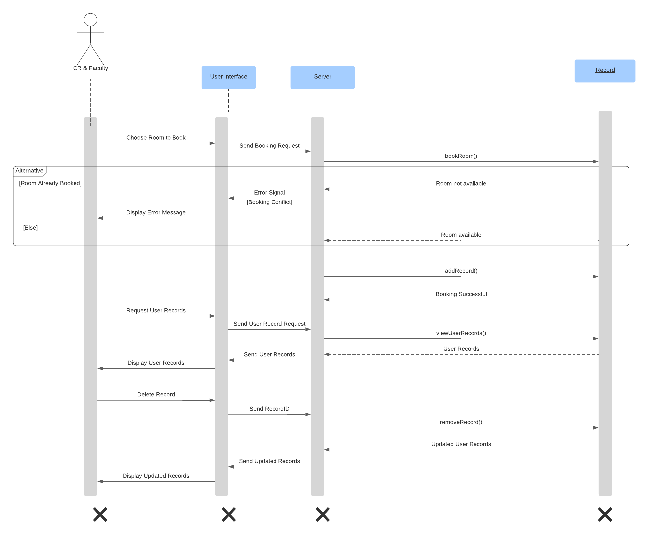
Sequence Diagram
(CR & Faculty)
06

Slide 11
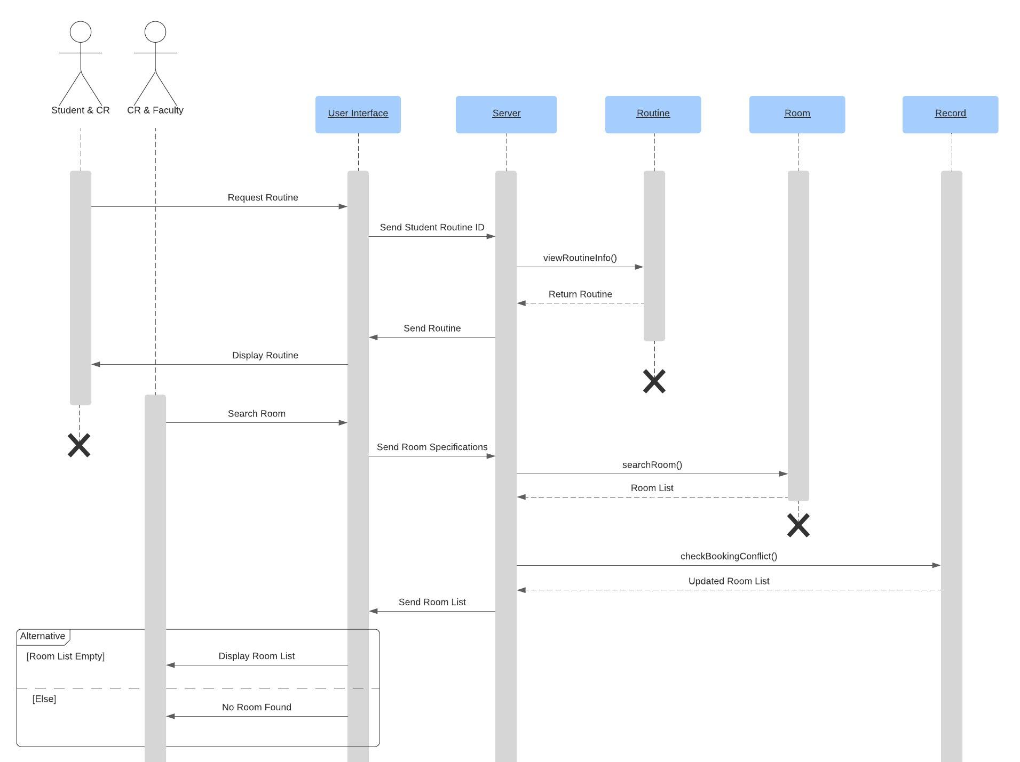
Sequence Diagram
(CR & Faculty)
06

Slide 12
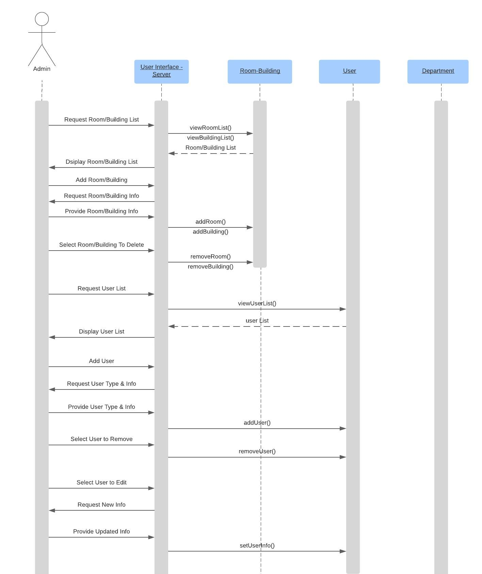
Sequence Diagram
(Admin)
07

Slide 13
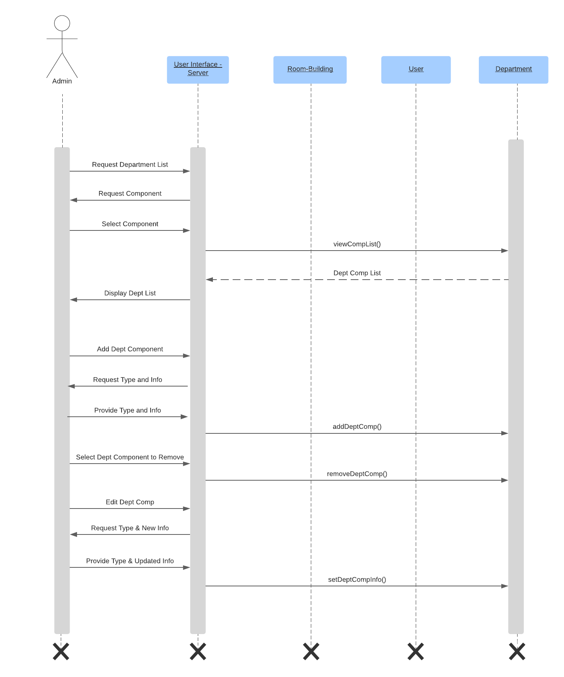
Sequence Diagram
(Admin)
07

Slide 14
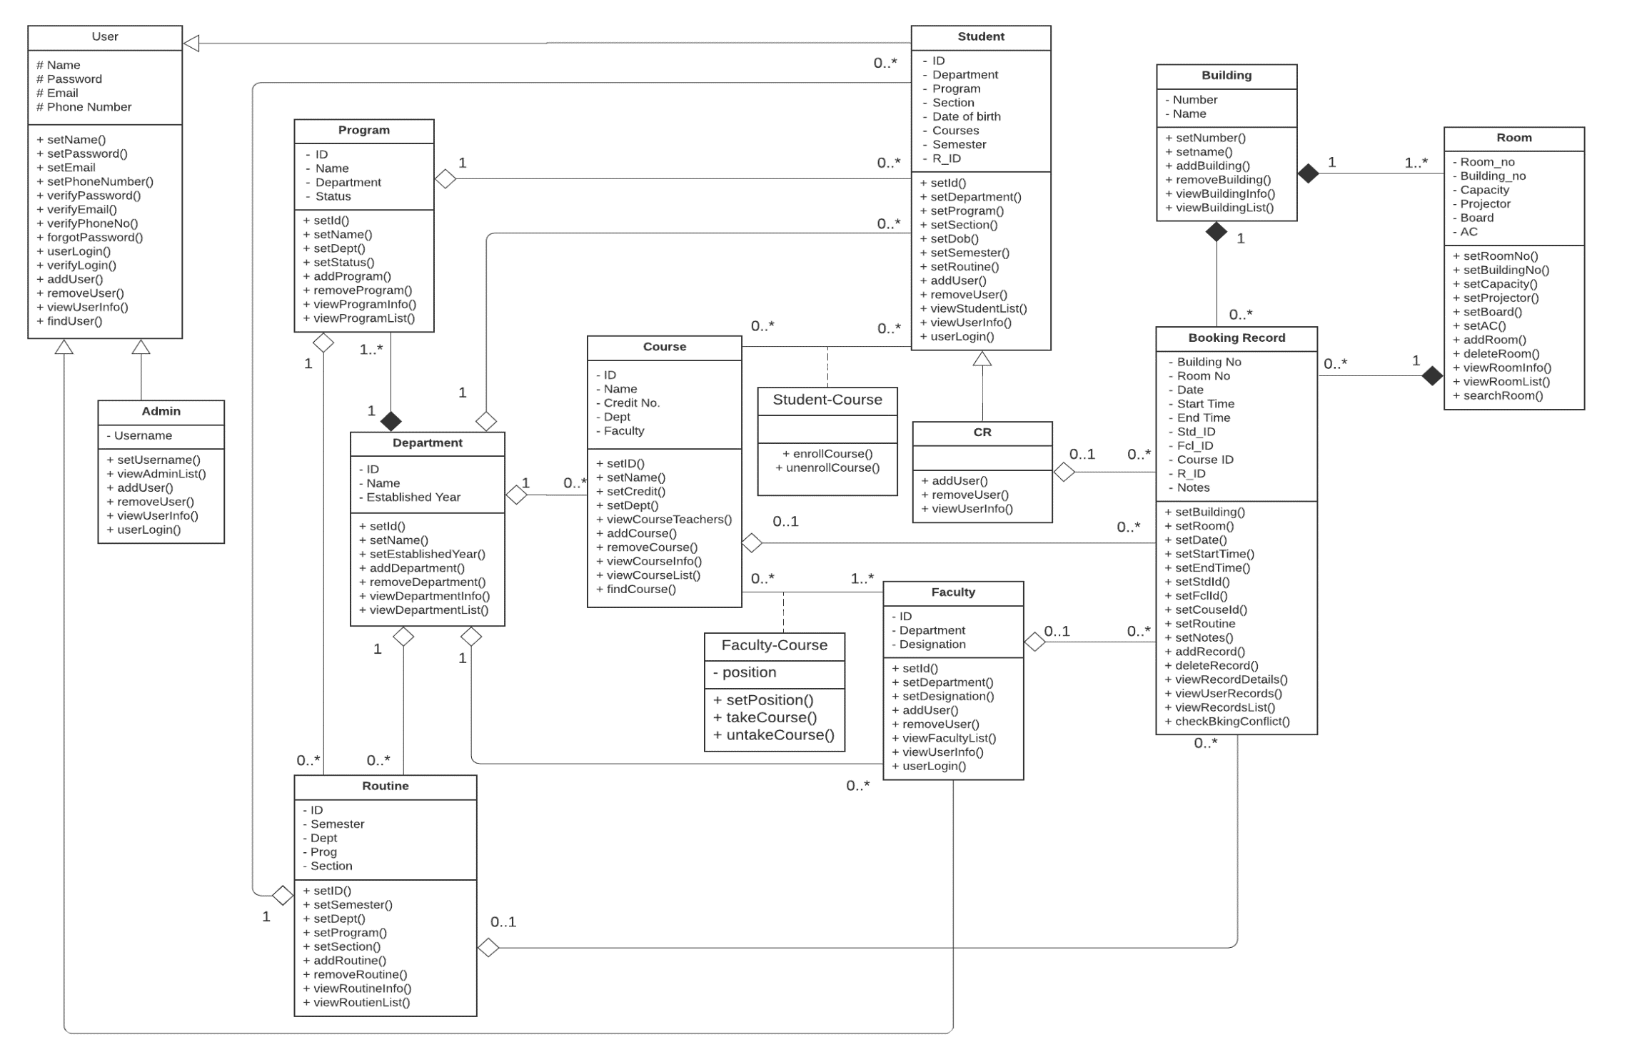
Class Diagram
08

Slide 15
THANK YOU

